Slide 1
DETAILING OF A BUILDING PLAN
STRUCTUAL DETAILING LAB - CEC307
2023-24 WINTER SEMESTER
SUBMITTED BY:- GROUP 3
SUBMITTED TO:- DR. RAHUL BHARTIYA
CONTRIBUTED BY:-
NISHA KUMARI, SONAL MANE, PRINCE TOMAR ,PIYUSH KUMAR, PRATIK RAJ, NEERAJ PARMAR, AASIF KAHN, SARFARAZ HAROON MAHESH NENAVATH, PRAVEEN, NISHANK

Slide 2
Problem Statement:
A two-story residential building is being proposed on a plot of area 500 m2 (Approx.). The client desires to construct the ground floor as an RCC structure and the first floor as a structural steel structure. Make suitable assumptions (including an architectural layout) as required.
Prepare the structural drawings of the above-mentioned project. The details should include but are not limited to grid layout, general arrangement drawings of floor plans (e.g., foundation, ground, first floor, and roof), typical sections, reinforcement details, steel members, steel connections, foundation details, etc.
The submission should include a set of printed A4/A3 drawings. Calculations are not required to be submitted. One submission per group shall be accepted.
[Note: Plans are drawn on scale of 1:100 ~ 1:250, while sections are drawn on a scale of 1:25 ~ 1:50]

Slide 3
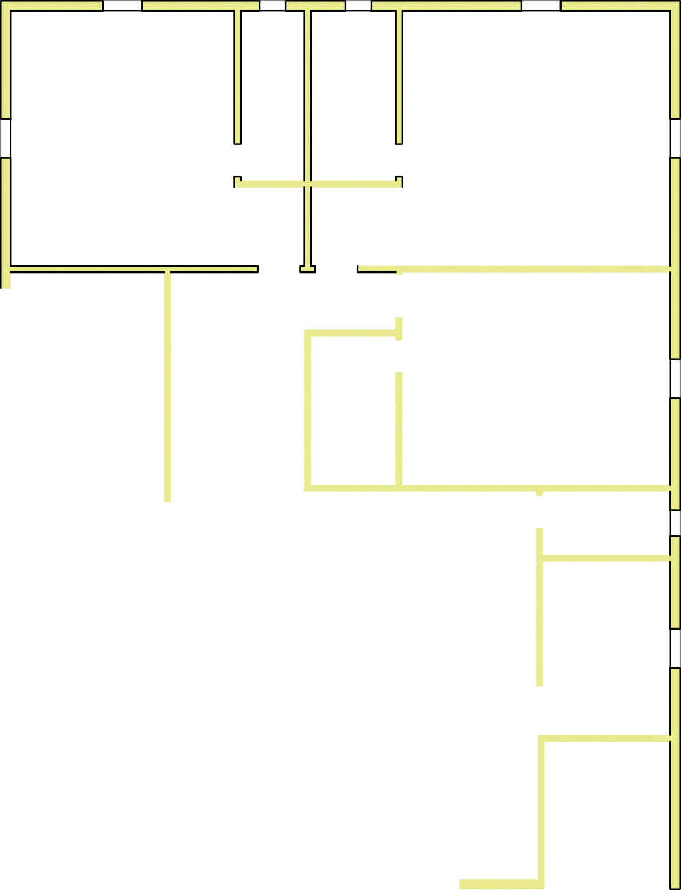


Floor Plan

Slide 4
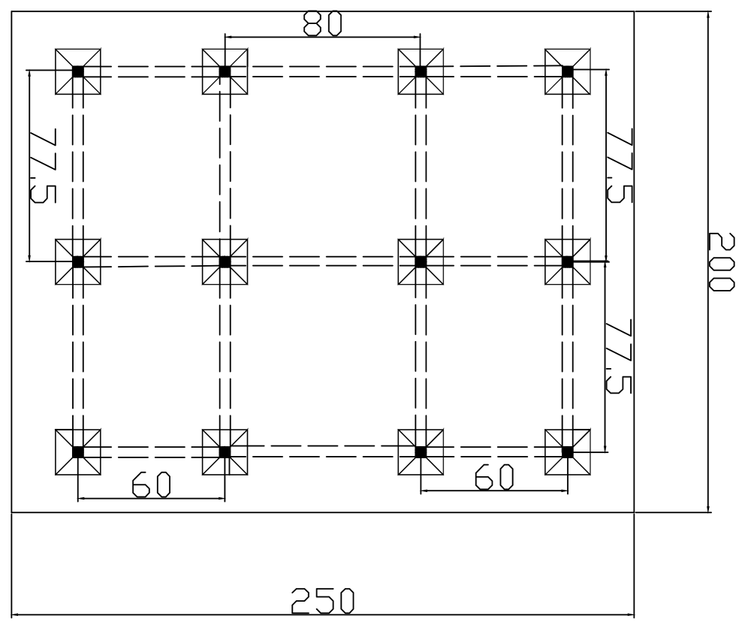
Column Plan

Slide 5
Footing Plan
20000mm
7750mm
7750mm
6000mm
8000mm
30
mm
350mm
dia# 8mm
5
E43
Bolted I section
of 250*250
ISHB 250
6000
350mm 250mm

Slide 6
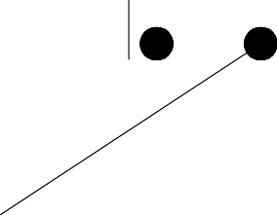






Footing Design
500
A
A'
8Ø@250mm
Starter Bars
75mm
200
500
1700mm
32Ø@438mm
525mm

Slide 7
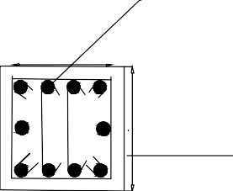
Column Design
25 mm dia #75mm
350mm
350mm
Section BB'
B
B'
1150 mm
10mm dia#300
75mm
500
450
450mm
450mm

Slide 8


Stair Design
1200
1200
200
180
Dia.8@250
1400
0.3L1
Nosing bars
4000
200
Dia.8@400
L1=3000
200
400

Slide 9
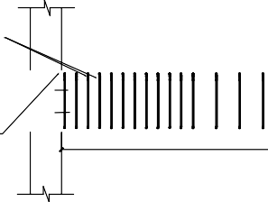
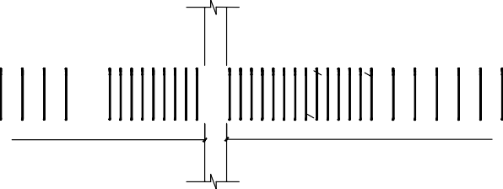
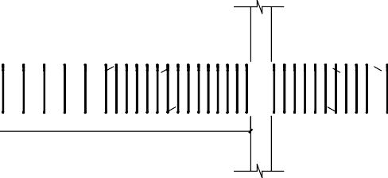
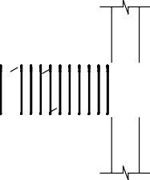



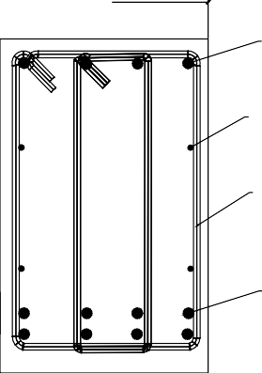
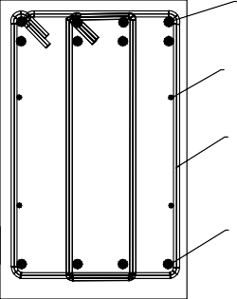
Beam Section-1
350
1912.5
350
1412.5
350
350
2-bar 25mm
1412.5
2-bar 12mm
1412.5
4-bar 25mm _{2-bar 25mm}
1912.5
+
2-bar 25mm
1412.5
2-bar 25mm
+
2-bar 25mm
847.5
+
2-bar 12mm
847.5 1147.5
+
2-bar 25mm
1147.5 847.525mm4-bar
2-bar 25mm
+
847.5
2-bar 25mm
4-bar 25mm
5650
7650
4-bar 25mm
4-bar 25mm
+
4-bar 25mm
4-bar 25mm
+
4-bar 25mm
4-bar 25mm
+
4-bar 25mm
2283.9
2573.1
4bar-25mm
8bar-25mm
4bar-12mm
4bar-12mm
8mm V Stirrups
4116.9
8mm V Stirrups
3654.3
4bar-25mm
8bar-25mm
Cross-section view of beam near support
Cross-section view of beam near center

Slide 10
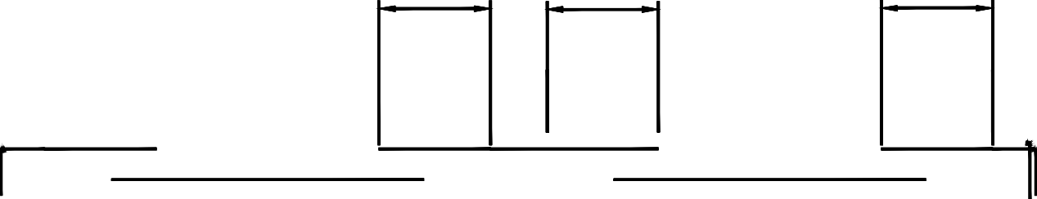




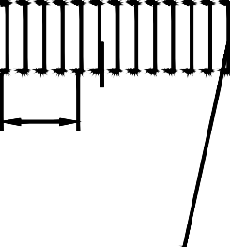
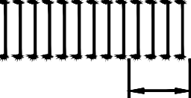
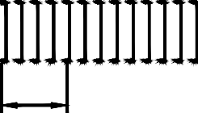
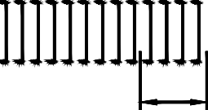




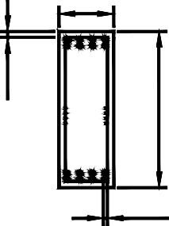


Beam Section-2
a'
b'
c'
1850
1850
1850
1850
7400
1110
1110
1110
1110
350
a
b
350
c
Ø8 100mm C/C
40
1000
25
section aa'
section bb'
section cc'

Slide 11
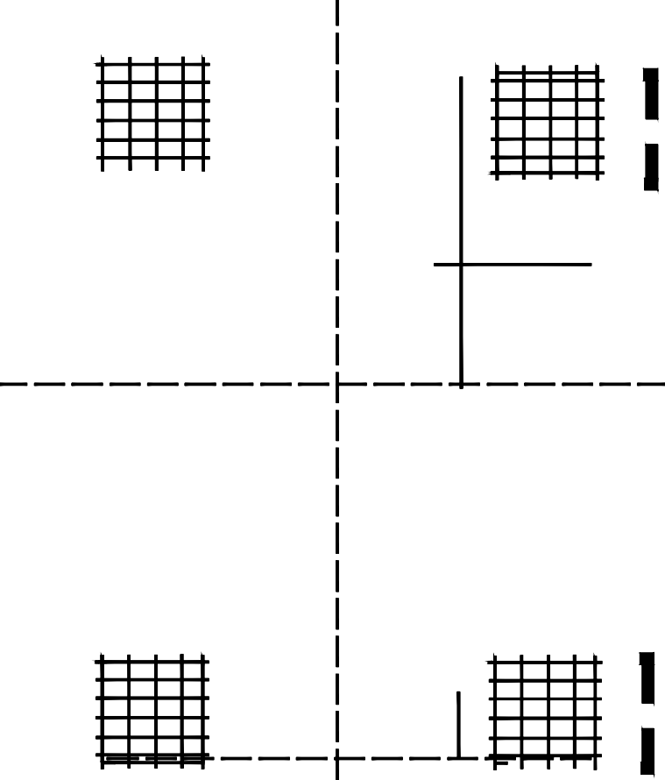

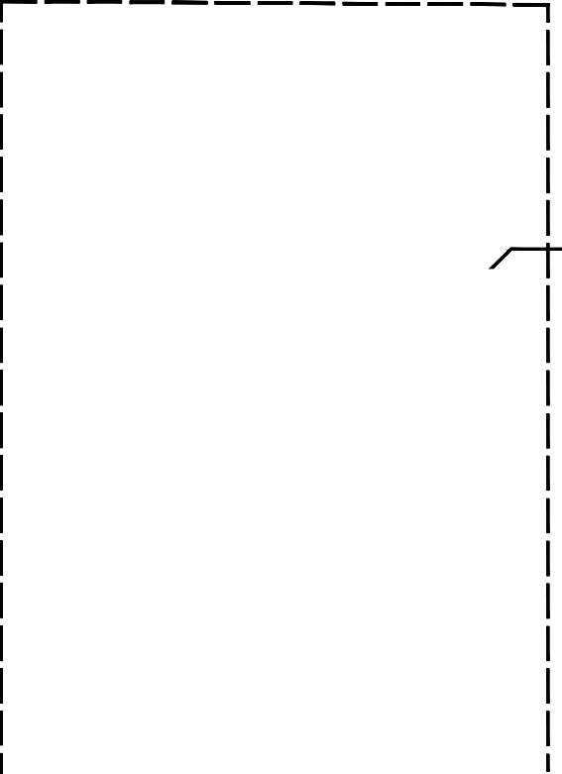




Slab Section 1
CLEAR COVER 25MM
B
CLEAR COVER 25MM
750mm
Ø10 @200MM
DETAILS OF DIST.BARS ALONG THIS LINE
7750mm
7750mm
600mm
A
DETAILS OF MAIN BARS ALONG THIS LINE
A
750mm
350MM
6000mm
B
SECTION B-B
SUPPORT
750mm
750mm
BARS Ø8
600mm
150MM
600mm
SUPPORT
150MM _{BARS}
Ø8
Ø8 @250MM
300MM
6000mm
SECTION A-A
350MM

Slide 12





Slab Section 2
B
8Φ @250C/C
8Φ @150 C?C both direction at Top and Bottom (Lx/5)
10Φ @200C/C
main bar
A
Distribution bar 10Φ @200C/C
SECTION BB''
A'
10Φ @200C/C
distribution bar
7850
8000
7850
285
(0.1Ly)
200
950
1520
760
(0.1Lx)
1520
7750
7600
950
(Lx/8)
950
B'
200
Main bar 10Φ @ 200C/C
7600
SECTION AA''

Slide 13
Bolted Connection

Slide 14
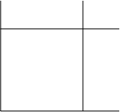

Slide 15
Thank You

